Slide 1

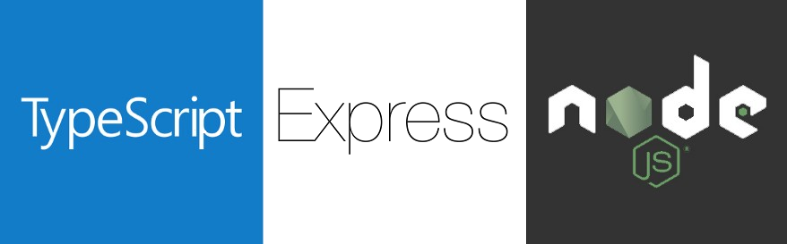
TypeScript Oriented Development
JavaScript Runtime
On Server Side

Slide 2

Why TypeScript?

Slide 3
Why TypeScript?
Bước lùi trong sự tiến hóa của ngôn ngữ lập trình và phát triển Web?
Phải khai báo rất nhiều type of variables?
Phải chờ đợi trong quá trình build dự án?
Strong typed language like a desktop developer
Use for larger projects
By definition, “TypeScript is JavaScript for application-scale development”
Type safe = less errors

Slide 4
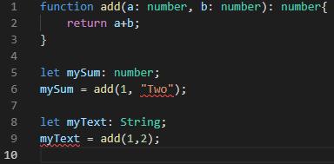
Why TypeScript?
Chương trình vẫn hợp lệ nếu sử dụng javascript thuần?
Notes:
On line 6: we are trying to pass a string parameter to a function that only accepts numbers. On line 9: we are trying to assign, to a string, the result of a function that returns a number. These two errors would go unnoticed, without Typescript, resulting in some bug on the final application.

Slide 5
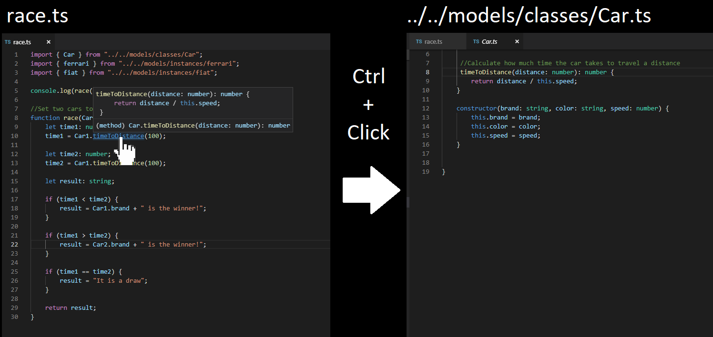
IDE - Why TypeScript?

Slide 6
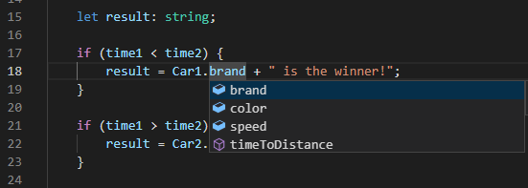
IDE - Why TypeScript?
We can say that Typescript is an enterprise language that overcomes this barrier.
Notes:
The difficulty of maintenance is one of the main reasons why Java and C # developers avoid migrating large projects to JS. We can say that Typescript is an enterprise language that overcomes this barrier.

Slide 7
References
https://angular.io
https://typescriptlang.org

